Slide 1
Employee Data Analysis using Excel
STUDENT NAME : | URMILA S
REGISTER NO : | 312213606
NM ID : | 5C379E0E6A6D3DF84EC41E793F5B3746
DEPARTMENT : | III YEAR B.COM (GENERAL)
COLLEGE : | TAGORE COLLEGE OF ARTS AND SCIENCE, CHROMPET.

Slide 2
PROJECT TITLE
Employee Performance Analysis using Excel

Slide 3


AGENDA
Problem Statement
Project Overview
End Users
Our Solution and Proposition
Dataset Description
Modelling Approach
Results and Discussion
Conclusion
3/21/2024 Annual Review

Slide 4

PROBLEM STATEMENT
Provide an Excel-based instrument for evaluating worker performance based on important parameters such as output, quality, attendance, and collaboration. A dashboard for data visualization, performance score calculation, and report generation should be part of the solution to help management make well-informed choices about training, promotions, and resource allocation.

Slide 5

PROJECT OVERVIEW
Developing an Excel tool to assess worker performance based on quality, productivity, attendance, and collaboration criteria is the goal of this project. With the use of the tool's dashboard for data visualization, automatic performance grading, and report production, management will be able to make well-informed decisions about how best to allocate resources and grow their workforce.

Slide 6

WHO ARE THE END USERS?
The end users of this employee performance analysis are typically:
1. Managers and Supervisors: To evaluate team performance, identify top performers, and address areas needing improvement.
2. Human Resources (HR) Department: For making decisions on promotions, training, and employee development programs.
3. Executives and Senior Management: To gain insights into overall workforce performance and inform strategic decisions on resource allocation and organizational planning.
4. Employees: To receive feedback on their performance and understand areas for improvement or recognition.

Slide 7

OUR SOLUTION AND ITS VALUE PROPOSITION
Filtering - Excel-based performance analysis tool efficiently filters employee data across KPIs, providing actionable insights for informed decision-making, enhancing organizational efficiency, employee development, and overall performance.
Conditional formatting - Excel's conditional formatting enhances employee performance data visualization, identifying high performers and trends, enabling quick, data-driven decisions for improved employee development and organizational success.

Slide 8
Pivot Table - Excel pivot tables enable dynamic analysis of employee performance data, providing real-time insights, trend identification, and data-driven decisions for improved resource allocation and performance management.
Chart - Excel-based performance analysis tool offers detailed dashboards, customizable visualizations, and filtering capabilities for tailored insights across KPIs, enhancing organizational efficiency and employee development.

Slide 9
Dataset Description
Employee data set- Kaggle
26 features
Features- 9 features
Emp ID
Gender- Male , Female
Performance
Business Unit
Name- First name
Rating- numerical
Job function
Department
Employee type

Slide 10

THE "WOW" IN OUR SOLUTION
Our Excel-based performance analysis solution is a game-changer in performance management due to its seamless integration of comprehensive data handling with powerful visual and analytical tools. It provides real-time insights through interactive pivot tables and dynamic charts, enabling users to filter and compare performance metrics, reveal actionable trends, and empower managers with clear, visually compelling reports.
3/21/2024 Annual Review
10

Slide 11
MODELLING
Data collection :- The data collection process involves gathering data from various sources, including HR systems, attendance records, project management tools, employee feedback, and self-assessments. It should include essential fields like employee ID, name, department, role, and joining date, as well as performance metrics like productivity, quality of work, attendance, and teamwork. The data should be relevant for trend analysis.
Data cleaning :- Data cleaning ensures accuracy and consistency by standardizing formats, removing duplicates, and addressing missing data. Validation checks ensure data falls within logical ranges, categorical data maintains consistent naming conventions, and outliers or anomalies are investigated for skewed results. Resolving inconsistencies in employee records or performance metrics ensures reliable analysis.
11

Slide 12
Techniques :- Data analysis techniques involve descriptive statistics to understand central tendencies and dispersion, normalization and scaling for comparability, weighting for KPI importance, trend analysis for performance data over time, comparative analysis for benchmarking against industry standards, and segmentation for deeper insights.
Results :- The analysis reveals top performers and areas for improvement based on KPI scores. Trends are identified, and recommendations include training for low performers and reallocating resources. The analysis supports strategic decisions like promotions or process improvements.

Slide 13
Pivot table :- Pivot tables enable users to customize data fields into rows, columns, values, and filters, allowing detailed aggregation and comparison of performance metrics. Filters and grouping options provide a structured view, allowing in-depth exploration of specific metrics by department, time period, or performance level.
Chart graph :- Charts and graphs are useful tools for data visualization, presenting performance metrics in various formats like bar charts, line charts, pie charts, heat maps, and radar charts. These visualizations help identify patterns, make informed decisions, and provide a multi-dimensional view of performance data.

Slide 14
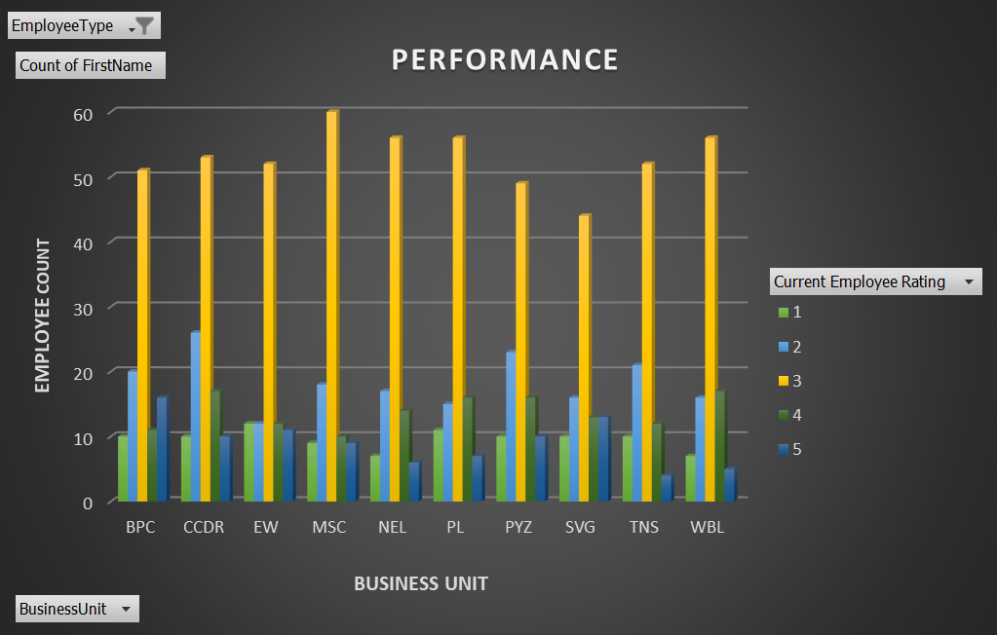
RESULTS
14

Slide 15
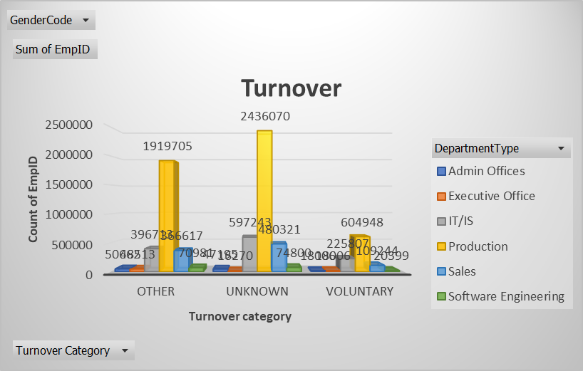

Slide 16
CONCLUSION
In conclusion, the data performance analysis for employee data provides a comprehensive and actionable overview of employee performance across various key metrics. By systematically collecting and cleaning data, employing robust analytical techniques, and leveraging visual tools such as pivot tables and charts, the analysis delivers valuable insights into individual and team performance. The results highlight top performers, identify areas needing improvement, and reveal trends over time, enabling targeted interventions and strategic decision-making. This data-driven approach enhances organizational efficiency, supports informed decisions on promotions and training, and ultimately drives overall business performance.

